Slide 1


Zeynep AÇIKGÖZ
07.02.2024

Slide 2

Outline
Executive Summary
Introduction
Methodology
Results
Conclusion
Appendix

Slide 3
Executive Summary
Utilizing data obtained from the public API of SpaceX and the SpaceX Wikipedia page, I conducted an in-depth analysis to predict successful landings. A pivotal step involved creating a 'class' column to categorize and label successful landings. Subsequently, I delved into the data using SQL queries, visualizations, Folium maps, and dashboards to gain insights.
In the process, I carefully selected relevant columns to serve as features for the machine learning models. Employing one-hot encoding, I converted categorical variables into binary form. Standardizing the data ensured uniformity and facilitated comparison. To optimize model performance, I employed GridSearchCV to identify the best hyperparameters.
Four machine learning models were implemented, namely Logistic Regression, Support Vector Machine, Decision Tree Classifier, and K Nearest Neighbors. Impressively, all models exhibited a consistent accuracy rate of approximately 83.33%. However, a notable trend emerged as all models tended to over-predict successful landings.
In conclusion, the analysis suggests that while the models provided reliable accuracy, there may be a need for additional data to enhance model determination and accuracy. This finding underscores the importance of continually refining and expanding datasets to achieve more robust and reliable machine learning models.

Slide 4
Introduction
In the competitive realm of commercial space exploration, SpaceX has emerged as a frontrunner, primarily due to its cost-efficient rocket recovery capabilities, notably in Stage 1. Capitalizing on this success, a new player, Space Y, aims to challenge SpaceX's dominance.
Recognizing the critical importance of predicting successful Stage 1 recovery for economic viability, Space Y has entrusted us with the task of training a machine learning model. The goal is to leverage historical data and relevant features to enhance the likelihood of successful Stage 1 recovery, thereby positioning Space Y as a formidable contender in the commercial space industry.
Our mission is to bridge the gap between space exploration and machine learning, offering Space Y a predictive tool that navigates the complexities of rocket recovery, ultimately contributing to their competitiveness in the evolving landscape of space commerce.

Slide 5
Methodology
Executive Summary
Data collection methodology:
Describe how data was collected
Perform data wrangling
Describe how data was processed
Perform exploratory data analysis (EDA) using visualization and SQL
Perform interactive visual analytics using Folium and Plotly Dash
Perform predictive analysis using classification models
How to build, tune, evaluate classification models

Slide 6
Data Collection
Space X API Data Columns:
The information obtained through API requests encompasses a range of crucial columns, including FlightNumber, Date, BoosterVersion, PayloadMass, Orbit, LaunchSite, Outcome, Flights, GridFins, Reused, Legs, LandingPad, Block, ReusedCount, Serial, Longitude, and Latitude. This rich set of attributes provides a detailed snapshot of each space mission, enabling a thorough analysis of various factors influencing the outcomes.
Wikipedia Webscrape Data Columns:
Simultaneously, we harnessed web scraping techniques to extract valuable insights from a table within Space X's Wikipedia entry. This additional source contributed essential columns such as Flight No., Launch site, Payload, PayloadMass, Orbit, Customer, Launch outcome, Version Booster, Booster landing, Date, and Time. The integration of these details augments the dataset, providing a more comprehensive perspective on the intricacies of each launch.

Slide 7
Data Collection – SpaceX API
GitHub url: https://github.com/zeynepackgz/appliedcapstoneproject/blob/main/Data%20Collectionspacex.ipynb
Requests(spacex)
Imputate missing PayloadMass values with mean
JSON files
Normalize data
Falcon 9 filter data
Dictionary data
dataframe

Slide 8
Data Collection - Scraping
GitHub url : https://github.com/zeynepackgz/appliedcapstoneproject/blob/main/Web%20Scraping.ipynb
Requests(wikpedia)
Cast dictionary to DataFrame
Beautifulsoup
Find launch info html table
Falcon 9 filter data
Iterate through table cells to extract data to dictionary
Create Dictionary

Slide 9
Data Wrangling
To facilitate machine learning model training, we've introduced a new 'class' column based on the 'Outcome' column components ('Mission Outcome' and 'Landing Location'). The 'class' column is binary: 1 for success and 0 for failure.Mapping:
True ASDS, True RTLS, True Ocean → 'class' set to 1
None None, False ASDS, None ASDS, False Ocean, False RTLS → 'class' set to 0
By aligning success with 'Mission Outcome' being True, we've established a concise labeling strategy. This approach streamlines the training process, allowing our model to learn and predict landing outcomes effectively.
Github url : https://github.com/zeynepackgz/appliedcapstoneproject/blob/main/Data%20wrangling%20.ipynb

Slide 10
EDA with Data Visualization
Conducted Exploratory Data Analysis (EDA) on key variables, including Flight Number, Payload Mass, Launch Site, Orbit, Class, and Year. Utilized various plots such as Flight Number vs. Payload Mass, Flight Number vs. Launch Site, Payload Mass vs. Launch Site, Orbit vs. Success Rate, Flight Number vs. Orbit, Payload vs. Orbit, and Success Yearly Trend. Leveraged scatter plots, line charts, and bar plots to scrutinize the relationships between these variables, assessing their viability for inclusion in the machine learning model training. The objective was to discern meaningful patterns and correlations that could contribute to the model's predictive accuracy.
GitHub url: https://github.com/zeynepackgz/appliedcapstoneproject/blob/main/Visualization.ipynb

Slide 11
EDA with SQL
Imported dataset into IBM DB2 Database. Utilized SQL Python integration for querying, aiming to enhance comprehension of the dataset. Extracted information on launch site names, mission outcomes, diverse payload sizes of customers, booster versions, and landing outcomes through targeted queries. This process facilitated a more in-depth exploration and understanding of key aspects within the dataset.
GitHub url: https://github.com/zeynepackgz/appliedcapstoneproject/blob/main/SQL.ipynb

Slide 12
Build an Interactive Map with Folium
Folium maps mark Launch Sites, successful and unsuccessful landings, and a proximity example to key locations: Railway, Highway, Coast, and City.
This allows us to understand why launch sites may be located where they are. Also visualizes successful landings relative to location.
GitHub url : https://github.com/zeynepackgz/appliedcapstoneproject/blob/main/Interactive%20Visual%20Analytics%20with%20Folium.ipynb

Slide 13
Build a Dashboard with Plotly Dash
The dashboard features a dynamic pie chart and a scatter plot for insightful data visualization. The pie chart offers the flexibility to showcase the distribution of successful landings across all launch sites or can be narrowed down to display individual launch site success rates. The scatter plot, which takes inputs for either all sites or an individual site, incorporates a payload mass slider ranging from 0 to 10000 kg. The pie chart provides a quick overview of launch site success rates, while the scatter plot allows for a detailed exploration of success variations across launch sites, payload masses, and booster version categories. This interactive dashboard enhances our ability to glean valuable insights from diverse perspectives within the dataset.
GitHub url : https://github.com/zeynepackgz/appliedcapstoneproject/blob/main/spacex_dash_app.py

Slide 14
Predictive Analysis (Classification)
GitHub url : https://github.com/zeynepackgz/appliedcapstoneproject/blob/main/MLPrediction.ipynb
Class from dataset
Confusion matrix and barplot model
Feature transform standard scaler
Split test set
Train_test_split()
Machine learning algorithm(knn, decision tree,svm)
GridSearchCV

Slide 15
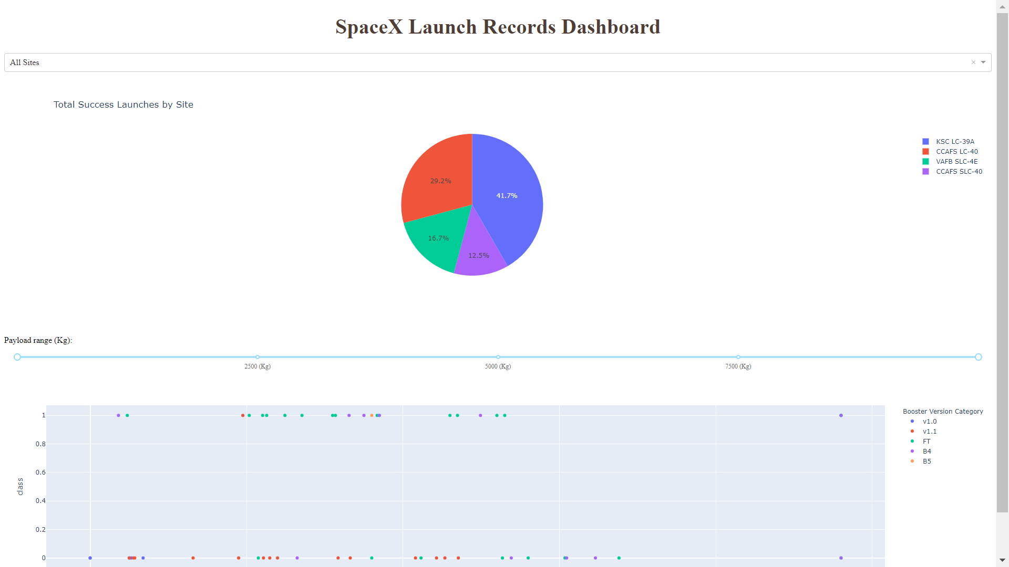
Results

Slide 16
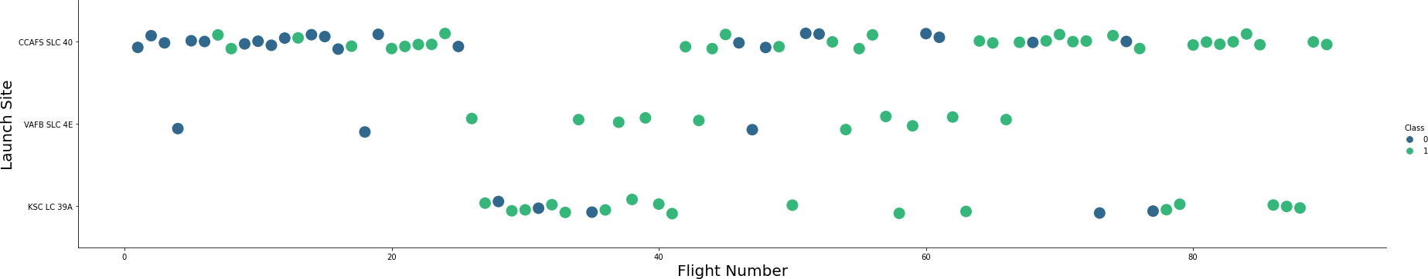
Flight Number vs. Launch Site

Slide 17
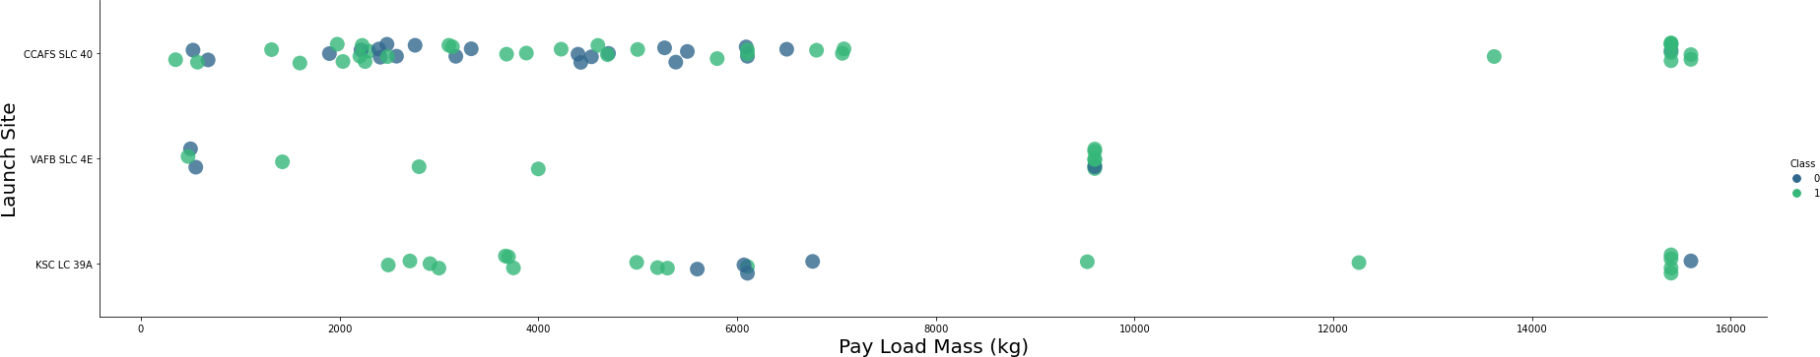
Payload vs. Launch Site

Slide 18
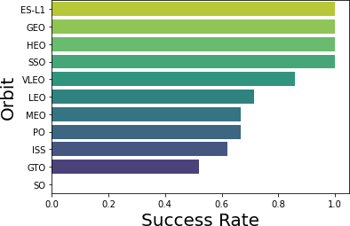
Success Rate vs. Orbit Type

Slide 19
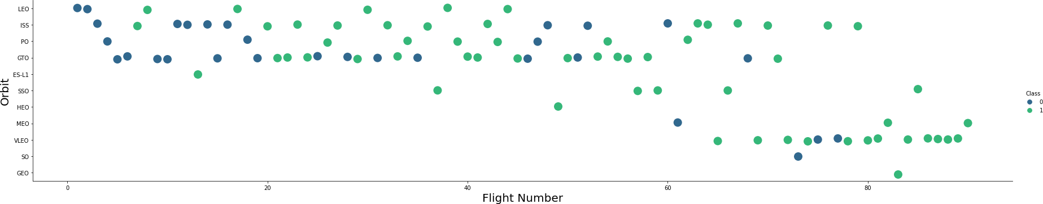
Flight Number vs. Orbit Type

Slide 20
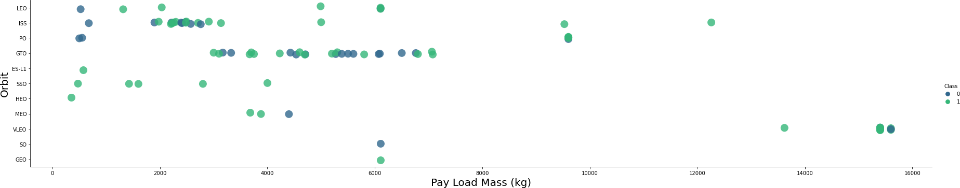
Payload vs. Orbit Type

Slide 21
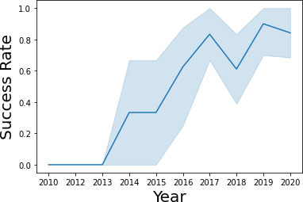
Launch Success Yearly Trend

Slide 22
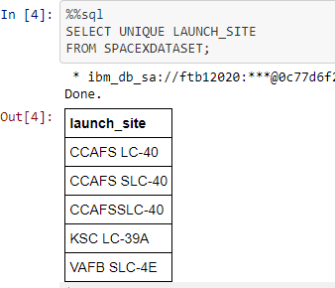
All Launch Site Names

Slide 23
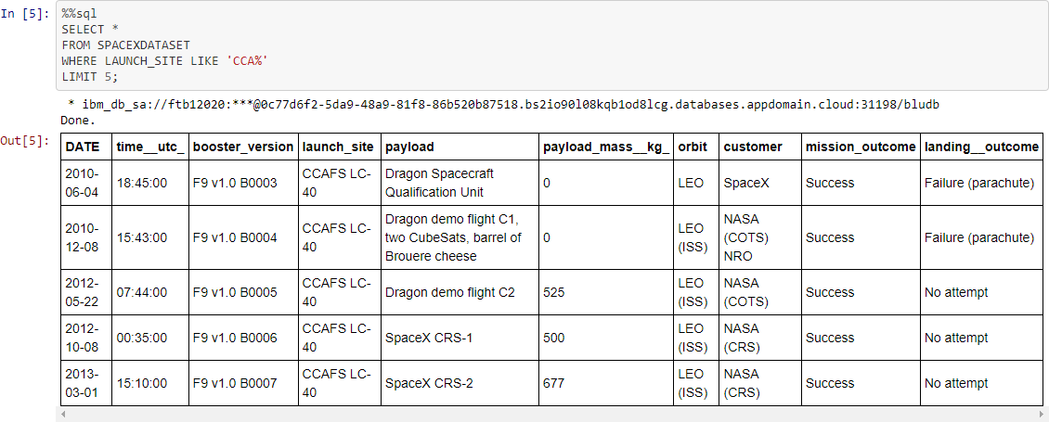
Launch Site Names Begin with 'CCA'

Slide 24
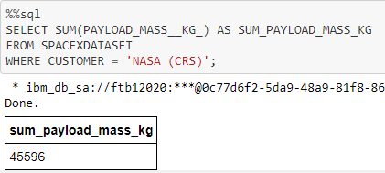
Total Payload Mass

Slide 25
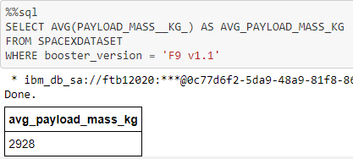
Average Payload Mass by F9 v1.1

Slide 26
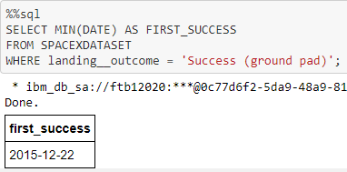
First Successful Ground Landing Date

Slide 27
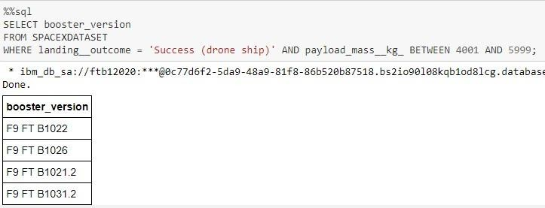
Successful Drone Ship Landing with Payload between 4000 and 6000

Slide 28
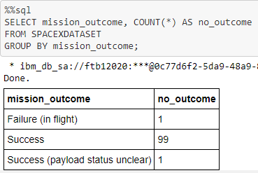
Total Number of Successful and Failure Mission Outcomes

Slide 29
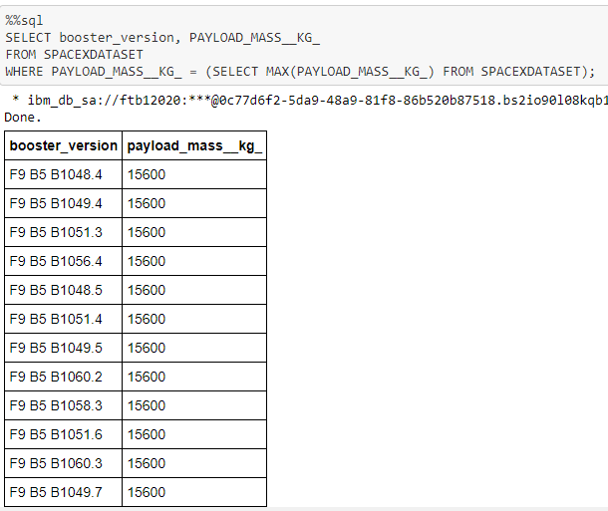
Boosters Carried Maximum Payload

Slide 30
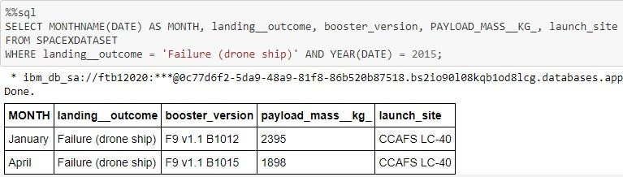
2015 Launch Records

Slide 31
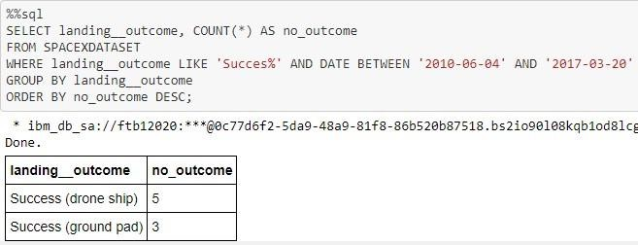
Rank Landing Outcomes Between 2010-06-04 and 2017-03-20

Slide 32

Site locations

Slide 33

Color-coded launch markers

Slide 34



Key location

Slide 35


Succesful launches

Slide 36

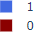
Success rate

Slide 37

Payload mass / success / booster version category

Slide 38

Classification Accuracy

Slide 39

Confusion Matrix

Slide 40
Conclusions
Task: Develop a machine learning model for Space Y to compete with SpaceX.
Goal: Predict successful Stage 1 landings, potentially saving ~$100 million USD per launch.
Data Sources: Utilized a public SpaceX API and web scraping from SpaceX Wikipedia.
Data Management: Created data labels and stored information in a DB2 SQL database.
Visualization: Implemented a dashboard for intuitive data representation.
Model Performance: Achieved an 83% accuracy with the machine learning model.
Decision Support: Allon Mask of Space Y can use the model to predict successful Stage 1 landings before launch, informing launch decisions.
Improvement Potential: Recommends collecting more data to refine the model for increased accuracy and effectiveness.

Slide 41
Appendix
url: https://github.com/zeynepackgz/appliedcapstoneproject

Slide 42


